Slide 1
BM327 Workshop 2
Identifying UTI Adhesion Factors
Dr Leighton Pritchard and Dr Morgan Feeney
Notes:
Welcome to the second BM327 bioinformatics workshop.
Today we’re going to work through some data analysis of data from a real experiment
We’ll be focusing on the identification of molecules produced by a uropathogenic E.coli that may, or may not, help it attach to the urinary tract and/or catheter tubing.

Slide 2
Structure
Introduction to ggplot2 (R)
Description of the experiment
Data analysis (R)
WebR in your web browser (see MyPlace link)
https://sipbs-compbiol.github.io/BM327-Workshop-2/
Notes:
The structure for today is in three main sections.
First, we’ll run through how to use ggplot2 – a data visualization package – in R. This will be a live coding demo and walkthrough.
Then we’ll describe the experimental approach that was used to obtain the data you’ll be working with, which will be more like a lecture.
Finally, we’ll work through the data analysis to identify whether or not candidate adhesion factors really do help a uropathogenic E. coli stick to catheter tubes or human tissue
All the R work you’ll do today will be carried out in your web browser using a neat technology called WebR. You’ll have met this last year in the year 2 workshops.
Doing things this way means that you can revisit the workshop for revision or other purposes later, and everything will still be set up for you.

Slide 3
Introduction to ggplot2

Slide 4
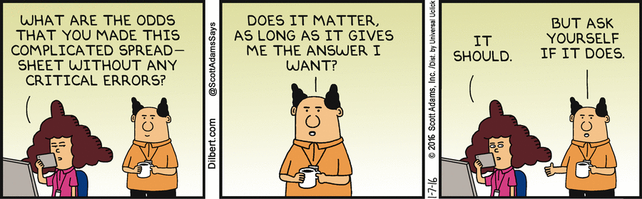
Why ggplot2 and R?
R is a free (as in beer/chips), widely-used, and robust statistical programming language
R is excellent for analysis and reproducibility (in science and elsewhere)
Separates data from analysis, easy to share/reapply analyses
R has many useful and advanced statistical tools for experimental/data analysis
ggplot2 is a powerful, flexible data visualization package in R
Notes:
You might be asking “why are you showing us ggplot2 and R?” – and it’s a fiar question. I mean, Excel and GraphPad Prism exist, and they’re nice tools.
But R has many advantages over those tools.
R is free, for a start – Excel and Prism cost money.
R is widely-used and has become the standard statistical software for scientific research. If you know R, you can slot in to many more environments.
What makes it so popular is that, unlike Excel and – to an extent – Prism, R is better for reproducible data analysis.
This is because it keeps the data and its analysis separate, for one thing. The original data remains unchanged, which may not be the case for a spreadsheet like Excel.
It also requires that you explicitly provide every instruction as a command in a script – there are no ”hidden” or unstated “point-and-click” steps that make analysis hard to reproduce.
These scripts can be shared, so anyone can easily check, reapply or re-use your analysis.
R also has a much wider (and easy to apply) range of advanced statistical tools for experimental data analysis – some of which are quite niche (e.g. for differential gene expression)
You’ve met R in the first and second year, but you may want a refresher on some things, so if you do please put your hand up and ask – others will thank you.
ggplot2 is the most widely-used data visualization package for R.
It produces publication-quality graphics directly.
It’s the graphics package used by many media organisations, like the FT, Economist, and 538.

Slide 5
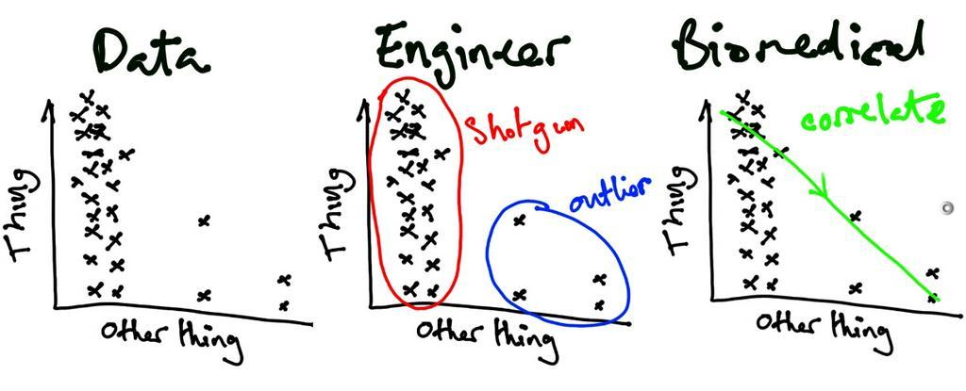
Visualisation is critical!
Data visualisation tells a scientific story
You need to choose the visualisation that tells the story of the work
Being constrained by “available plot types” is limiting
ggplot2 allows you to build up the visualisation you need
Notes:
As a scientist, you need to communicate your data to others.
When you do so, and intentionally or not, you are telling a story.
So when you share your data, you need to be sure that you are telling the right story
Different people can look at the same dataset and “see” different things in that data.
As a scientist your job is to “see” the _correct_ things and share them with others.
So you need to be able to choose the visualization that tells the _correct_ story.
Tools like Excel give you a palette of possible graphs and shoehorn your data into those graphs.
ggplot2 lets you build up your plots from first principles to show exactly what you need to show.

Slide 6
The grammar of graphics
Separates data from its representation
We can make many different possible plots from the same dataset
Start by defining the data, and then layer on representations of the data
Build plots from combinations of simple elements
Like making a sentence out of adding words together
Plots/sentences can be simple or complex, but they should express what you mean
Data; aesthetics; geoms; layers
Notes:
ggplot does this by using something called the grammar of graphics
The most important thing to understand is that the grammar of graphics separates data from its representation
This is just expressing the obvious idea that we can make many different possible plots from the same dataset
So we start by defining the data, and then layering on representations of the data
What you end up doing is building a visualization out of combinations of simple elements, like making a sentence out of adding words together.
The plots (or sentences) you make can be simple or complex, but they should express clearly what you mean by putting the elements in the right order
There are four kinds of component (or word): data, aesthetics, geoms, and layers

Slide 7
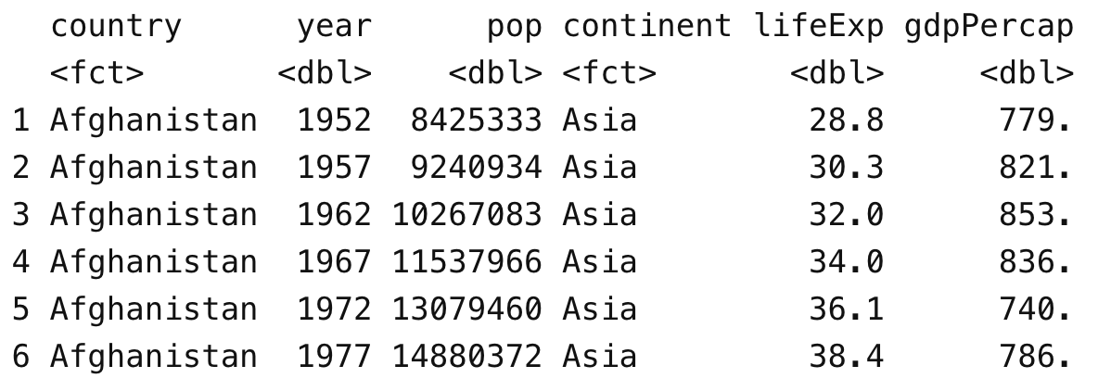
What is a plot? (data)
Your data is usually a table
One row per observation
One column per variable
Each cell is the value of a variable for a particular observation
Notes:
The first component of a plot is the data that gets plotted.
Usually this is in the form of a table, and good tables have a particular format.
In good tables, each row represents a single “observation”, and each column represents a single “variable” that is measured for each observation.
Every cell in the table is then the value of a variable for a particular observation

Slide 8
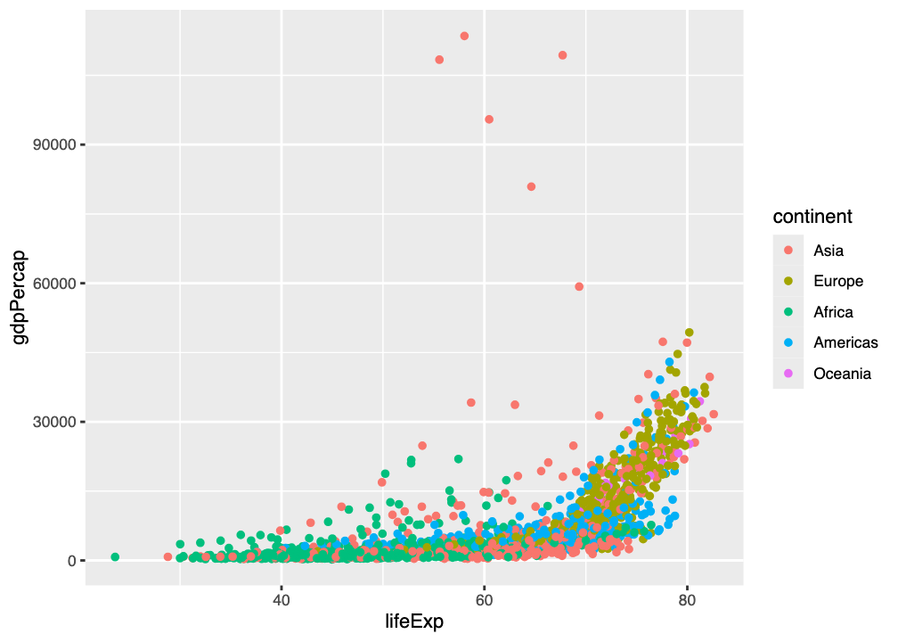
What is a plot (aesthetics)
Each value in the table can potentially be rendered in a plot
The aesthetics of the value determine how it is rendered
Shape
Size
Colour
Co-ordinates on the image
Changing aesthetics changes the plot but not the data
Many different plots can be made by changing aesthetics alone
Notes:
Every value in the data table can in principle be rendered in the plot you make.
How that value looks in the plot is controlled by its “aesthetics” – qualities like the shape of the symbol, its size and colour, and even where it is placed on the image.
Changing the aesthetics (e.g. making points from Asis look like squares, making point size represent total population, or colouring by country) changes the plot, but does not change the underlying data

Slide 9
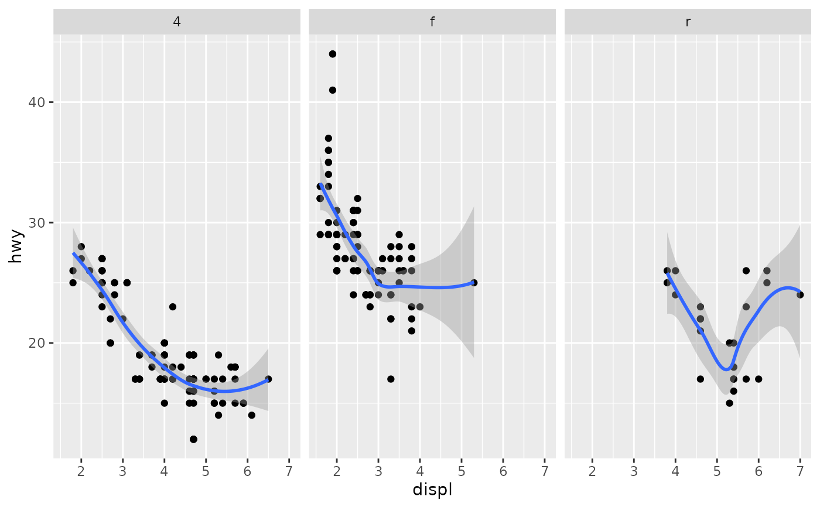
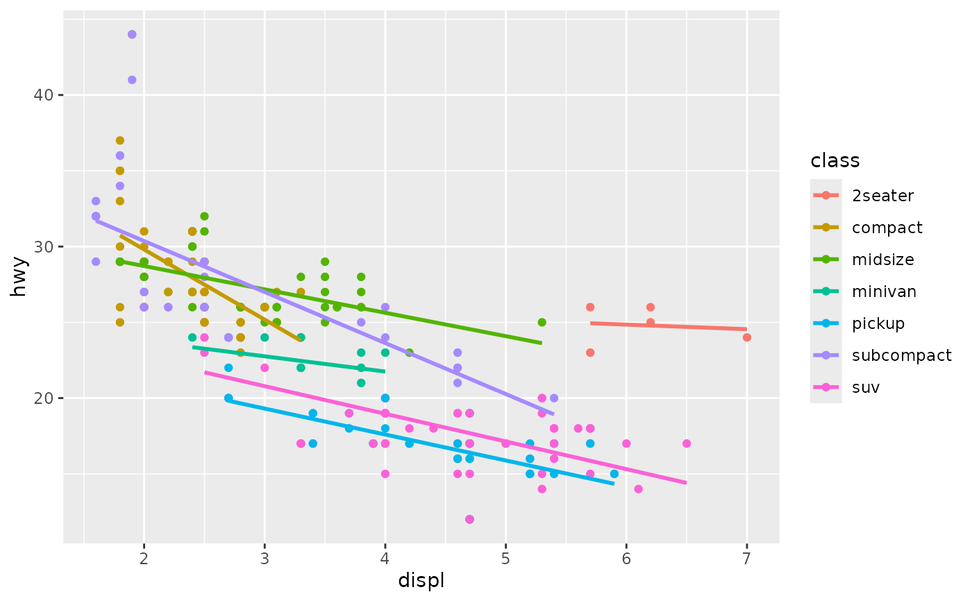
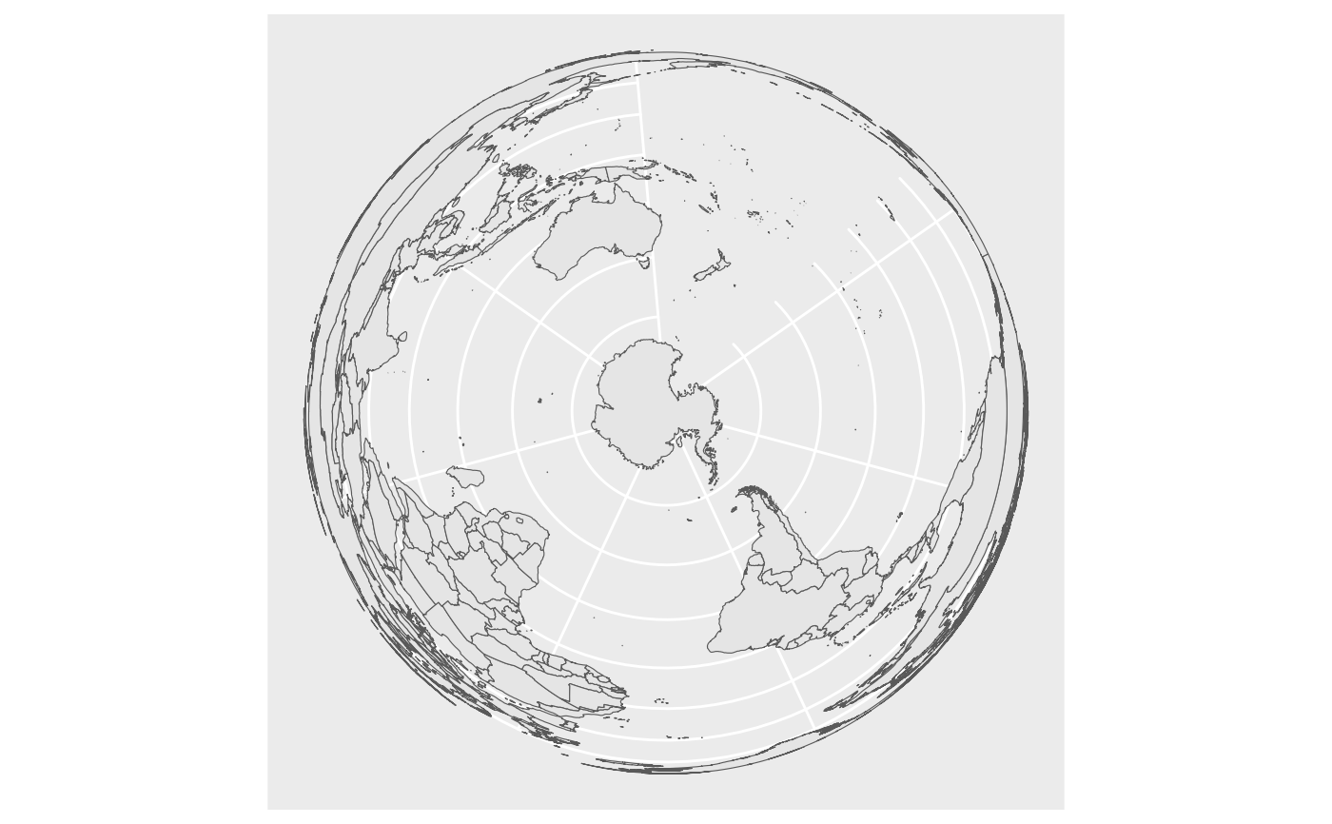
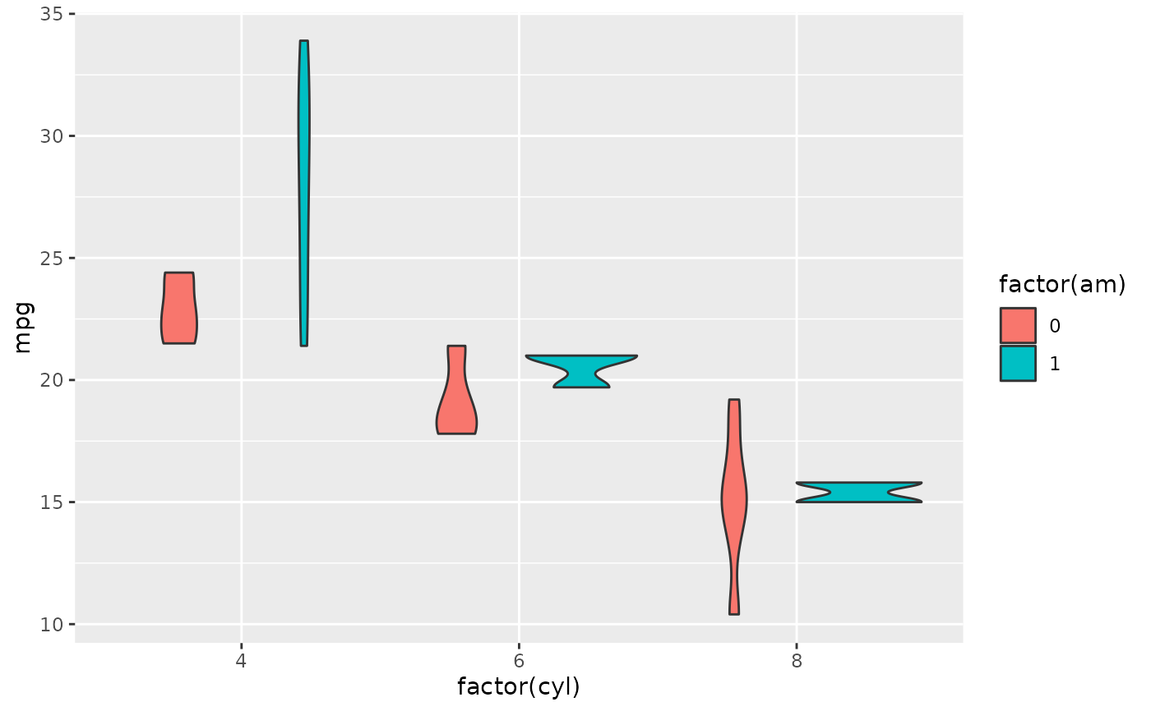
What is a plot? (geoms)
geoms (“geometries”) are a jargon term in ggplot2
geoms define the “type” of representation and can be combined
Draw as points: scatterplot
Draw as lines: line graph
Draw as bars: bar chart
Draw as box and whisker: boxplot
Draw as density plot: KDE/distribution
Draw as geographical coordinates: map representations
Draw as vertical density plot: violin plots
Draw variability as ribbon: ribbon plots
The same data/aesthetics can be shown using different geoms
Notes:
The next component to consider is the geom, or geometry.
This is a slightly jargony term – a geom defines the “type” of representation of the data
Geoms define things like scatterplots, line graphs, violin plots, geographical maps and so on
We can use the same aesthetic settings with different geoms to generate a wide range of possible graphs
We can also combine geoms with each other to show, for example, a line through the data, with every data point individually plotted, and a ribbon overlaying it to show variation in the data.

Slide 10
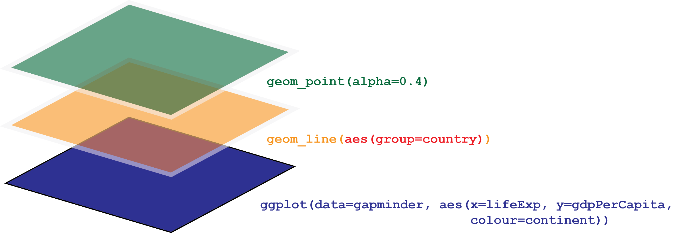
What is a plot? (layers)
geoms can be combined in layers
Notes:
The way we combine geoms is as layers – like putting one page on top of another (though they’re transparent, to an extent)
We start with a base layer – ggplot - where we define the data (here “gapminder”), and some aesthetics - these will be inherited by each subsequent layer
Then we add a new geom layer, here geom_line to make a line graph
And we can continue adding new layers on top of what we’ve already done, such as geom_point, to add all the individual datapoints
When we add a new geom layer, we can choose to override or modify data or aesthetics.
Here, we’ve chosen to add an aesthetic that _groups_ datapoints by country. You’ll see what this does as we go through the walkthrough.

Slide 11
Interactive demo
Let’s work through “The grammar of graphics” on the workshop pages

Slide 12
The Experiment
Investigating UTI adhesion

Slide 13
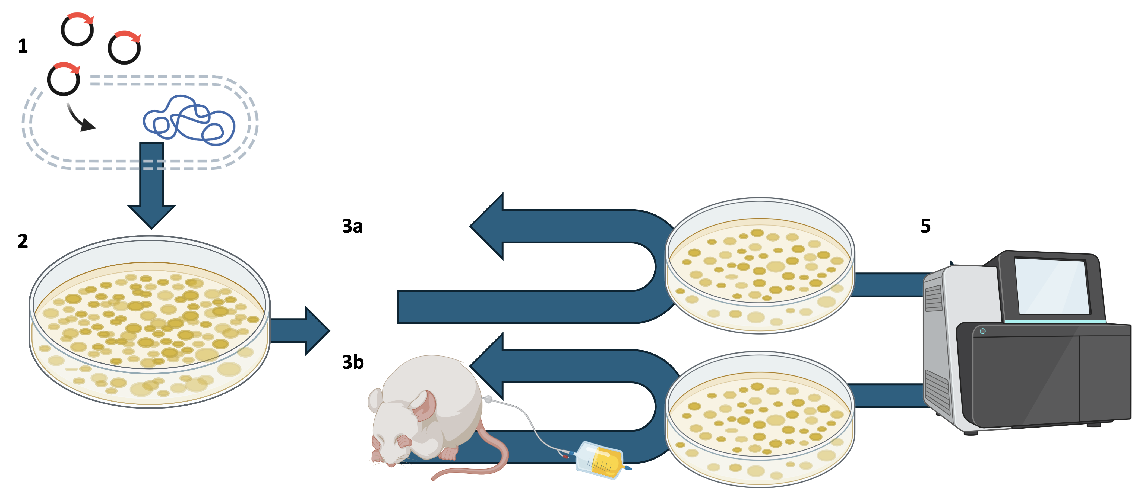
A high-throughput genomic screen
Notes:
This is a visual summary of the initial high-throughput genomic screen that was used to identify candidate adhesion factors.
We have two strains of E. coli: one is a urinary tract pathogen (UPEC), and one is not (DH10B).
We suspected that some genes in UPEC contributed to the “stickiness” or adhesion of UPEC in a urinary tract environment, and wanted to find out what they are.
So we set up a high-throughput genomic screen.
Steps 1 was to create a bacterial artificial chromosome (BAC) library.
This involves breaking up the UPEC genome into smaller fragments (150-350kbp) with a restriction enzyme, and cloning these fragments into vectors.
The vectors are then transformed into E. coli DH10B, which is not a urinary pathogen – step 1
We pool these transformats all together into a collection we call a library (step 2)
The hope is that genes that make UPEC “sticky” will be activated in DH10B and make it ”sticky”, too. All we have to do then is identify the “sticky” transformants and work out what UPEC sequences they contain.
So, in step three, we apply artificial selection to the library using serial passage.
We put the library through two separate parallel selection pressures
In one of these (3b), we introduce the library to a catheterized mouse model, and let the bacteria grow for a bit. Then we remove the catheter, wash it, and culture new bacteria from the surface.
We repeat the selection a few times with these cultured bacteria, to really ramp up the selection pressure.
At the same time, in (3a) we go through the same process but without the mouse model.
This acts as a control, because passaging is also a selection pressure in its own right, and we want to know specifically what the effect of interaction with the mouse urinary tract is.
After a few rounds of serial passage, in step (5) we sequence the cultures that remain, to see which UPEC genes have been carried through, specifically in the mouse system.

Slide 14
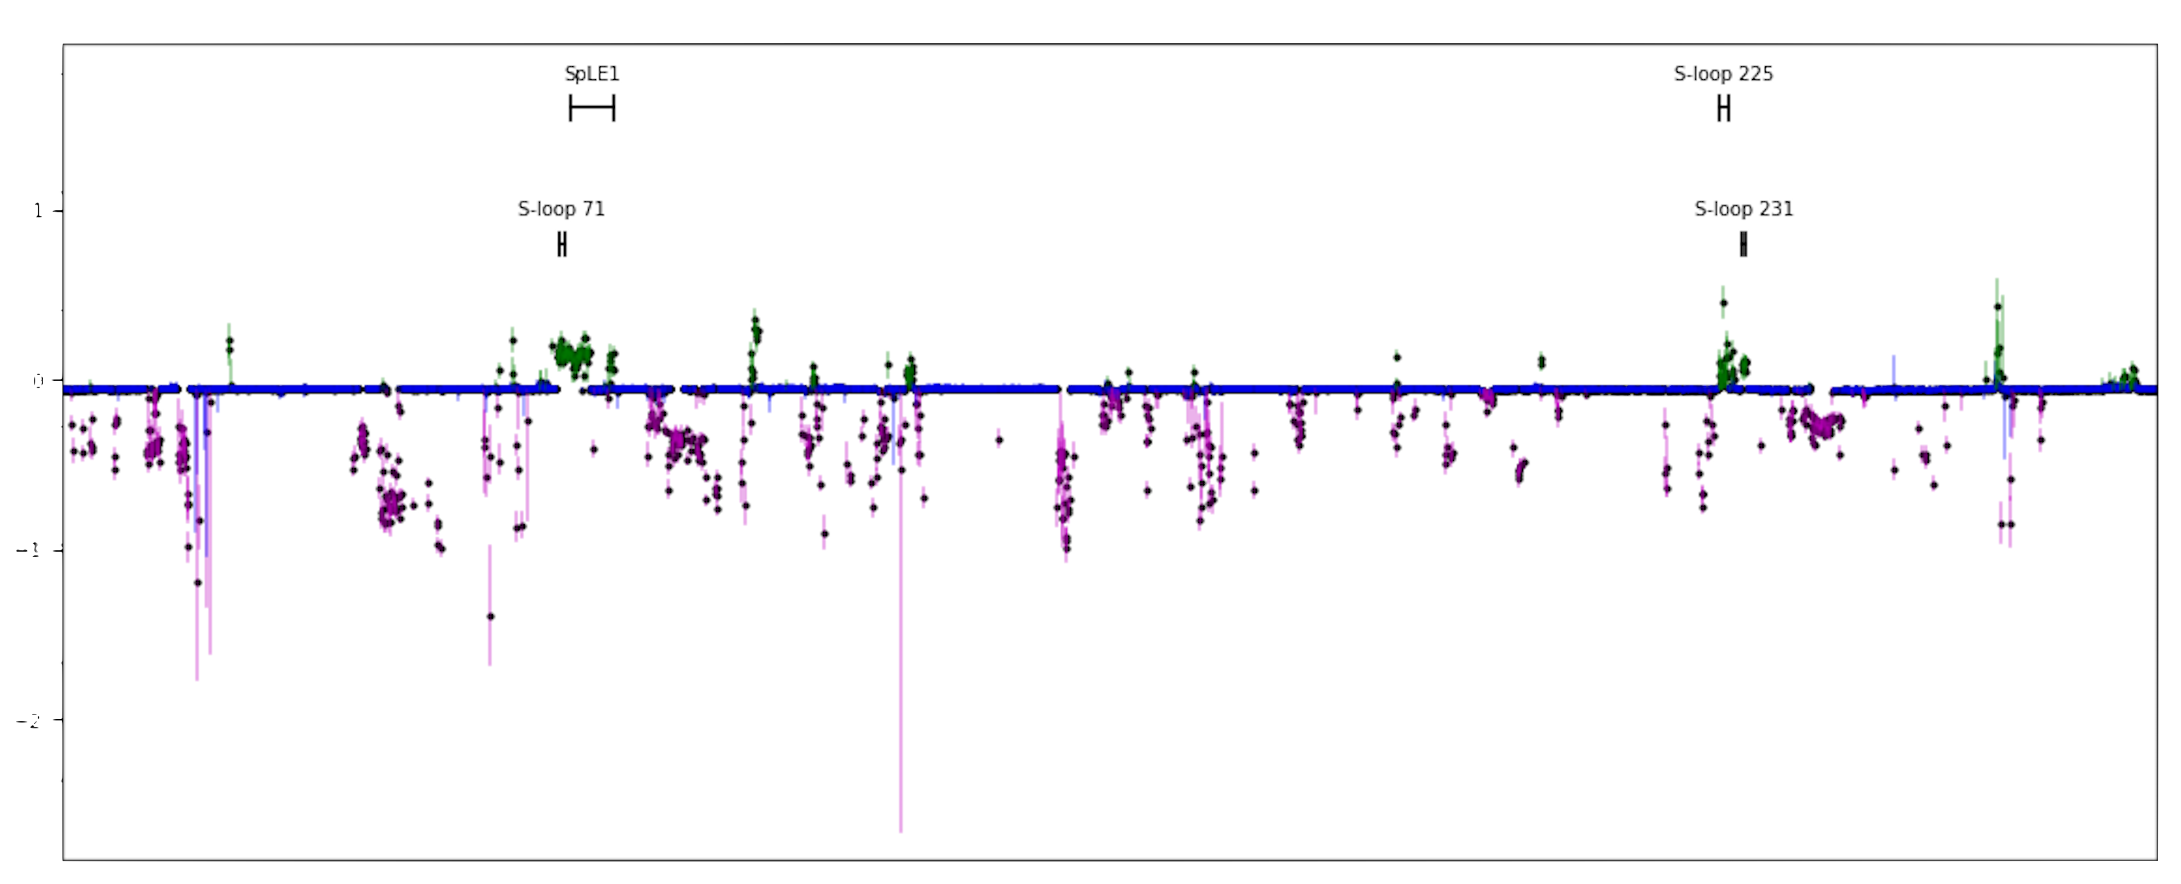
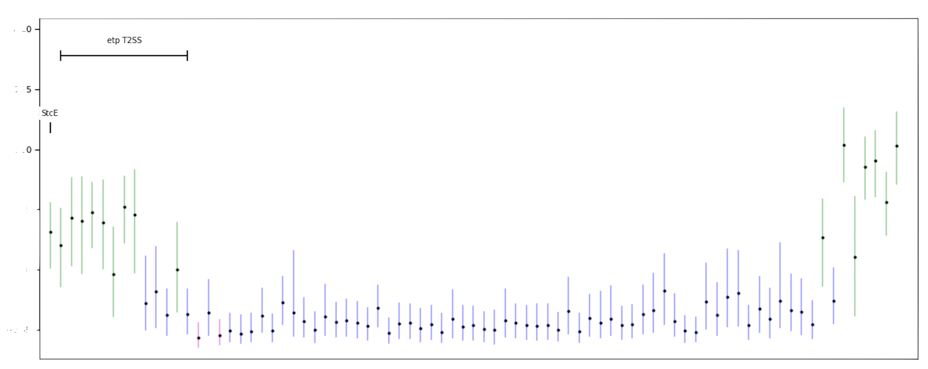
High-throughput results
T2SS carried on the plasmid
gene etpD essential for T2SS production
Knockout/complement experiment for etpD
Notes:
After some serious statistical analysis, we ended up with these two key plots.
At the top, we have the UPEC genome, showing the extent to which recovered genes are over-represented (green) or under-represented (purple) after mouse passage.
Blue means there’s no statistically meaningful change in abundance.
We’re interested in the clusters/patches of green genes.
This UPEC also has a plasmid, which cariies a type 2 secretion system – that’s the lower image.
The T2SS is indicated in green, as being overrepresented after mouse passage.
We suspected that the T2SS might be important for attachment to the host and/or the catheter, so we focused on this for a knockout/complement experiment.
Specifically, as the etpD gene is essential for T2SS production, we decided to carry out a knockout/complementation experiment for etpD

Slide 15
Knockout experiment
(Falkow’s) Koch’s postulates
The wild-type/control pathogen containing etpD must be able to adhere to human tissue/catheter material
The mutant organism lacking only etpD must not adhere to human tissue/catheter material
A complemented mutant, with etpD restored, must be able to adhere to human tissue/catheter material
We test (catheter material, human tissue sample):
Wild-type/control (expected to adhere)
etpD knockout (expected not to adhere)
etpD knockout with empty plasmid (expected not to adhere)
etpD knockout complemented with plasmid carrying etpD (expected to adhere)
Notes:
We run a knockout experiment to test whether the etpD gene has an involvement in UPEC adherence.
This is designed to satisfy Koch’s postulates (as reworked by Falkow for molecular analyses), such that we can tentatively accept that etpD is involved in adherence if
The wild-type/control pathogen adheres to the material
A mutant lacking only etpD fails to adhere
A complemented mutant, with etpD restored, adheres to the material
Practically, we test the wild type, the knockout mutant, and the complemented mutant
But we also include a knockout mutant with an empty plasmid to test for any effect this might have on adherence (not that we expect any)

Slide 16
Knockout experiment
We introduce to either human tissue or catheter material…
Wild-type/control UPEC (expected to adhere)
etpD knockout (expected not to adhere)
etpD knockout with empty plasmid (expected not to adhere)
etpD knockout complemented with plasmid carrying etpD (expected to adhere)
We thoroughly wash/rinse the material and use serial dilutions to obtain bacterial counts (logCFU)
High counts imply that bacteria adhered
Low counts imply that bacteria did not adhere well
THIS IS AN INDIRECT TEST OF ADHERENCE
Notes:
In the practical experiment we expose two kinds of material to the four bacterial strains: catheter material and human tissue
After a suitable period we thoroughly wash/rinds the material and culture it, obtaining bacterial counts by serial dilution
If there are high bacterial counts, many bacteria must have adhered to the material
Ifl there are low counts, the bacteria must have been washed off and not adhered so well
Note that we are not testing adherence directly – we are measuring levels of recovery of bacteria and inferring differing levels of adherence from how many CFUs we recover.

Slide 17
The Workshop
What you’ll be doing
Notes:
So that’s the experimental setup which gets you the logCFU data you’ll be analysing.
What will you actually be doing?
There’ll be a lot of new stuff here, but don’t worry we’ll walk through it together.

Slide 18
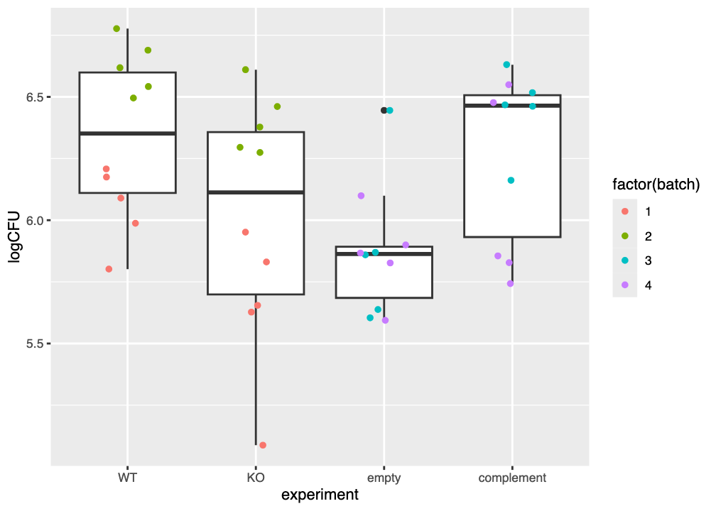
Data visualisation
Use ggplot2 to visualise the experimental results
Use geom_boxplot() and geom_jitter() geometries
Colour datapoints by batch
Obtain plots for catheter and human tissue
What do you notice?
Notes:
Firstly you’ll be using ggplot2 to create figures like this one on the right, showing the experimental data for catheter material and for human tissue.
This will introduce a couple of new geoms (boxplot and jitter)
We’ll use this to make some important inferences about our data.

Slide 19
Statistical modelling
This may well be new to you
A different philosophy to null hypothesis significance testing (NHST)
(things like t-tests, ANOVA, etc.)
We’ll use linear modelling (simple to do in R)
We explicitly, simultaneously, and quantitatively estimate the effect of each intervention, relative to the wild-type/control:
etpD knockout
addition of empty plasmid
complementation
any interference effects (e.g. batches of experiments run at different times/with different media/by different people)
Notes:
You’ll also be doing some statistical modelling.
This will be a new approach to what gets taught elsewhere on the course, I think.
It’s a totally different philosophy to things like t-tests and ANOVA, what we call “null hypothesis significance tests”
(though t-tests and ANOVA are just special cases of what we’ll be doing)
The approach we’ll take is called linear modelling
It’s very powerful, and allows us to simultaneously estimate the effects all our strains have, in relation to the wild-type/control strain.
It also allows us to take into account, and cancel out, interference/noise from influences we’re not interested in, like batch effects of running at different times, or if the media batch changes

Slide 20
A high-level view of linear modelling
We are measuring some kind of outcome
Here, we measure logCFU bacterial recovery
We assume that the measured value depends (“~”) on some influence
The measured logCFU for the wild-type UPEC depends on us using the wild type
logCFU ~ wildtype
Notes:
In our experiments we’re usually measuring some kind of outcome.
Here, the outcome is the logCFU value from the knockout/complementation experiments
The way we set up our experiments implies that some factors of the experiment influence the measured value.
For instance, the logCFU recovered for the wild-type strain depends on us using the wildtype.
In a slight abuse of mathematical notation, we can write this as the equation: logCFU ~ wildtype

Slide 21
A high-level view of linear modelling
In reality, there is some variation in measurement
e.g. wind on the balance, slight differences in growth time
We assume these variations are random, and represent them as ε
Linear modelling lets us “subtract” these random effects and estimate the actual influence of “wildtype”
logCFU ~ wildtype + ε
Notes:
In reality there’s always some random variation from somewhere.
So we represent these variations in our equation with the epsilon symbol (short for error)
From the structure of the equation you can see that, if we can subtract these random errors, we can obtain an estimate of the actual influence of the wildtype – i.e. the expected bacterial recovery when using the wildtype.
Linear modelling lets us mathematically make this subtraction, and get a much better estimate of the actual influence of the wildtype.

Slide 22
A high-level view of linear modelling
We can account for multiple influences by adding further terms into the equation
When considering the knockout strain for example, there are two influences
Recovery appropriate for the wildtype
A change in recovery due to the ΔetpD knockout (expected to be negative)
We assume that we can add these
Linear modelling estimates the influences of both wildtype and ΔetpD simultaneously
logCFU ~ wildtype + ΔetpD + ε
Notes:
A major advantage of linear modelling is that we can use it to estimate the influence of multiple factors simultaneously.
For example, the knockout strain’s recovery is influenced both by it being the wildtype strain (UPEC), and having had the etpD gene knocked out (ΔetpD).
These influences are assumed to add together: the recovery is that for the wildtype, subject to the difference induced by knocking out the gene etpD.
Using linear modelling, we can estimate the influence of both the wildtype and the ΔetpD knockout at the same time, in a single calculation.

Slide 23
A high-level view of linear modelling
We can extend this to all of the experimental factors.
There are two influences
Recovery appropriate for the wildtype
A change in recovery due to the ΔetpD knockout (expected to be negative)
A change in recovery due to presence of the plasmid vector (expected to be 0)
A change in recovery due to presence of the complement (expected to be positive)
Linear modelling estimates the influences of all of these simultaneously
logCFU ~ wildtype + ΔetpD + vector + complement + ε
Notes:
This idea can be extended to all of our experimental factors.
We expect the wildtype strain to give a certain level of recovery, but for this to be modulated if the etpD gene is knocked out, or if the plasmid vector is transformed into it, or if the etpD gene is complemented back in.
There are details to consider about how we design the experiment, but linear modelling allows us to estimate all of these effects simultaneously in one calculation.

Slide 24
Accounting for batch effects
This experiment is subject to batch effects
These become an extra term in the equation for linear modelling
If there are four batches we write this as batch_{i} to mean the appropriate one of {batch₁, batch₂, batch₃, batch₄} and add it to the equation
This is a “linear mixed effects model”, and subtracts out the influence due to each individual batch to give better estimates of experimental factors
logCFU ~ wildtype + ΔetpD + vector + complement + batch_{i} + ε

Slide 25
Interactive Demo
Let’s work through the workshop pages

